Slide 1
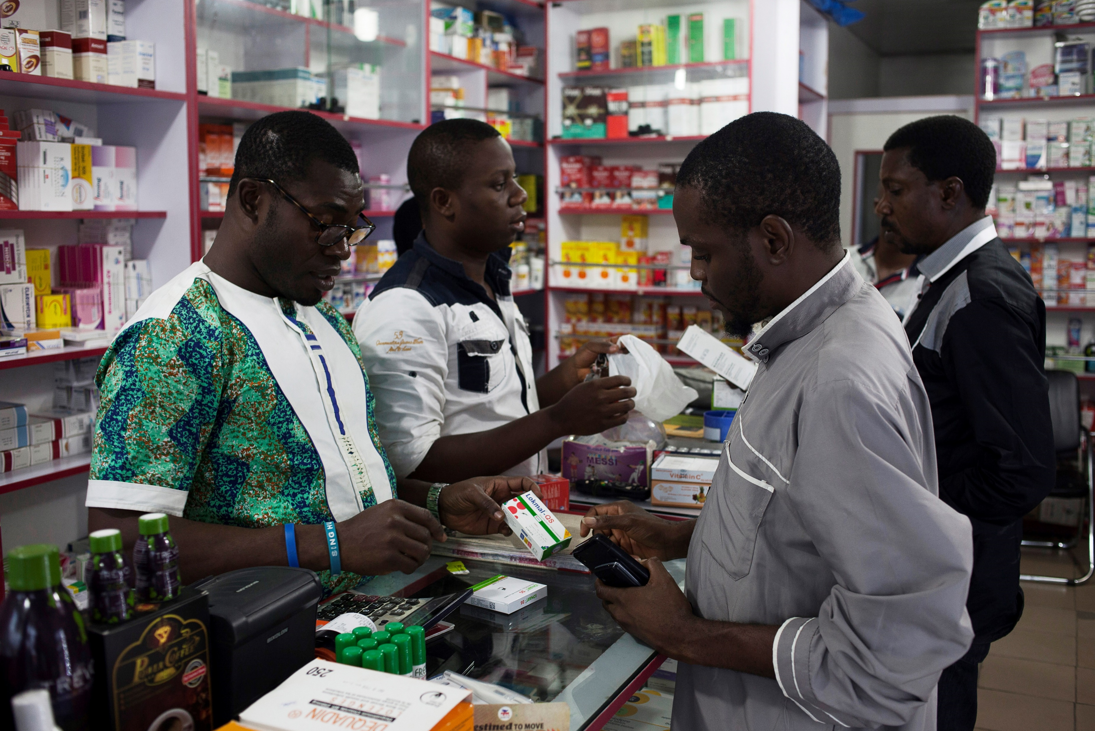


[Country, Year]
Module 7: Summary and Pilot

Slide 2
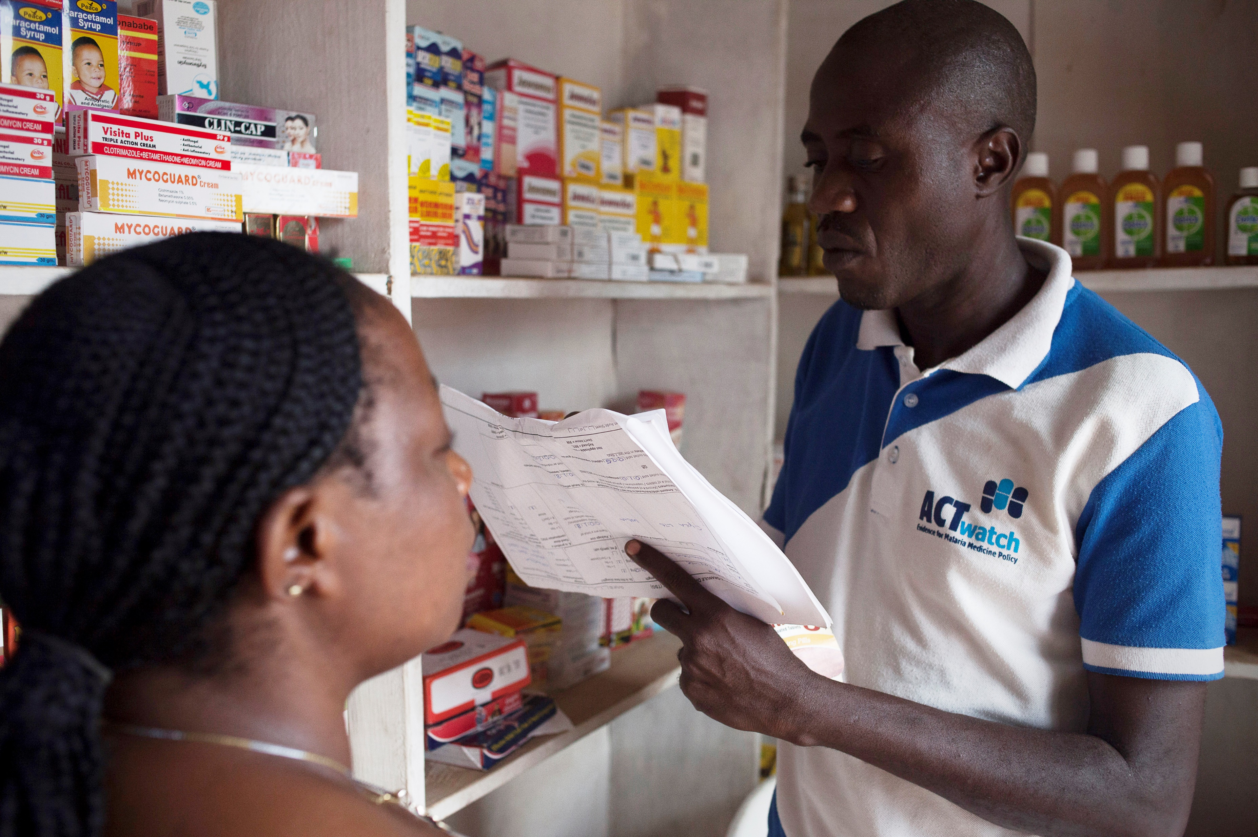
outline
PILOT DAY 1 + debrief
PILOT DAY 2 + debrief
PILOT DAY 3 + debrief
POST-TEST
Additional suggested topics:
Sharing field experience
Finalizing list of data collectors and field team supervisors
Team building and deployment
Administrative formalities

Slide 3
Suggested agenda
PILOT
Day 7- 9
Time | Content
AM | 7.1 Pilot
PM | Debrief
Suggest splitting into groups of 3-4 to visit various outlet types. Ensure outlets have been alerted to the study and aware of the visit. Assign one person from each group to take notes on feedback on the questionnaire, interview process, etc. to share back with the full team.
Day 10
Time | Contents
9:00-10:00 | Post-test
10:30-10:50 | Break
10:50 11:30 | Post-test review, final data collectors and field team supervisors selection
10:50-12:50 | [suggested discussion] Sharing field experience
 | [suggested discussion] List of data collectors and field team supervisors
13:00-14:00 | Lunch
14:00-15:00 | [suggested discussion] Team building and deployment
15:00-15:20 | Break
15:20-16:00 | [suggested discussion] Administrative formalities (payment)

